Slide 1
INTRO to natural language processing
10/2019
Analytics Consulting Group

Slide 2
All workshop materials can be found here:
bit.ly/2ICgMT4

Slide 3

Who am I?
Dev Sharma
Applied Analytics Student (Fall 2018 Batch)
Worked in Boutique Tech. Consulting for four years
Interned with Infosys this past summer
Focus heavily on NLP with Python
Contributor for Analytics Vidhya

Slide 4
Contents
What is NLP?
Examples of NLP applications
Types of NLP Tasks
Regular Expressions
Tokenization
Count vs. TFIDF Vectorization
Topic Modelling with PCA and NMF
Naïve Bayes Classifier
Embeddings / Word2Vec Models
Recurrent Neural Networks
Transformers / Transfer Learning
Ethical Implications

Slide 5
What is Natural Language Processing?
Helps machines understand human languages, bridging the “language barrier” between machines and humans so to speak
This is how we understand the world around us:

Slide 6
What is NLP (continued)?
This is how machines are taught to perceive the data we feed them:

Slide 7
Examples of NLP Demo Applications
Named Entity Recognition
https://demo.allennlp.org/named-entity-recognition
Part of Speech Tagging
http://www.infogistics.com/posdemo.htm
Text Generation
https://talktotransformer.com/
QA
https://www.pragnakalp.com/demos/BERT-NLP-QnA-Demo

Slide 8
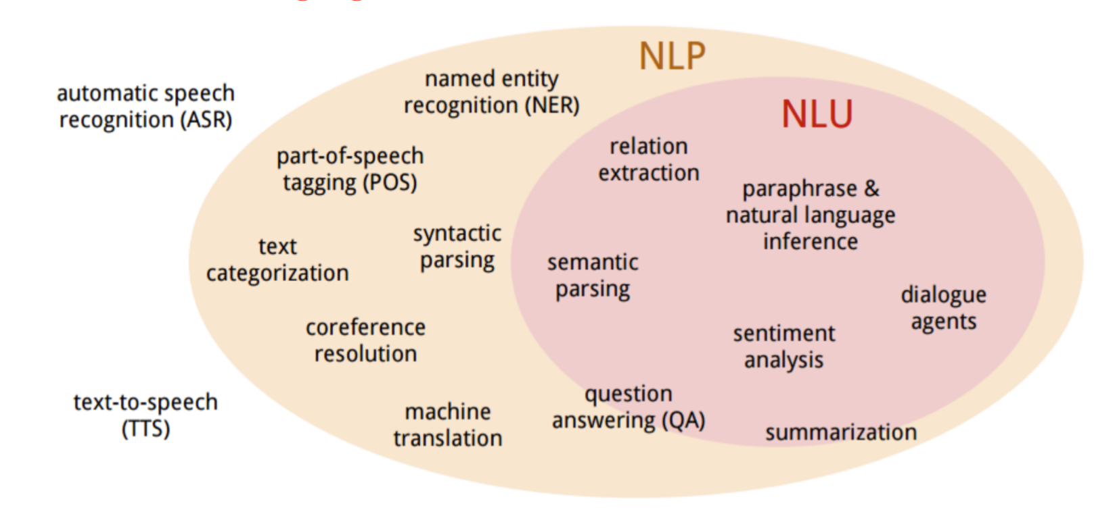
Types of NLP Tasks
- NLP and NLU (U = Understanding) are often used interchangeably

Slide 9
Other
Rest of the material will be covered along with the workshop Jupyter notebook at bit.ly/2ICgMT4

Slide 10
Resources
Courses
Fast.ai - Code-First Introduction to NLP
https://www.fast.ai/2019/07/08/fastai-nlp/
Articles
My work with Google’s BERT:
https://medium.com/@devkosal
Attention
https://jalammar.github.io/visualizing-neural-machine-translation-mechanics-of-seq2seq-models-with-attention/
NLP vs. NLU
https://www.bmc.com/blogs/nlu-vs-nlp-natural-language-understanding-processing/

Slide 11
Q & A
Connect with me on LinkedIn with any follow-up Questions:
https://www.linkedin.com/in/dev-sharma1/

